Slide 1



Assignment_3
View in Power BI
Last data refresh:
6/22/2022 5:55:15 PM UTC
Downloaded at:
6/22/2022 5:56:03 PM UTC

Slide 2
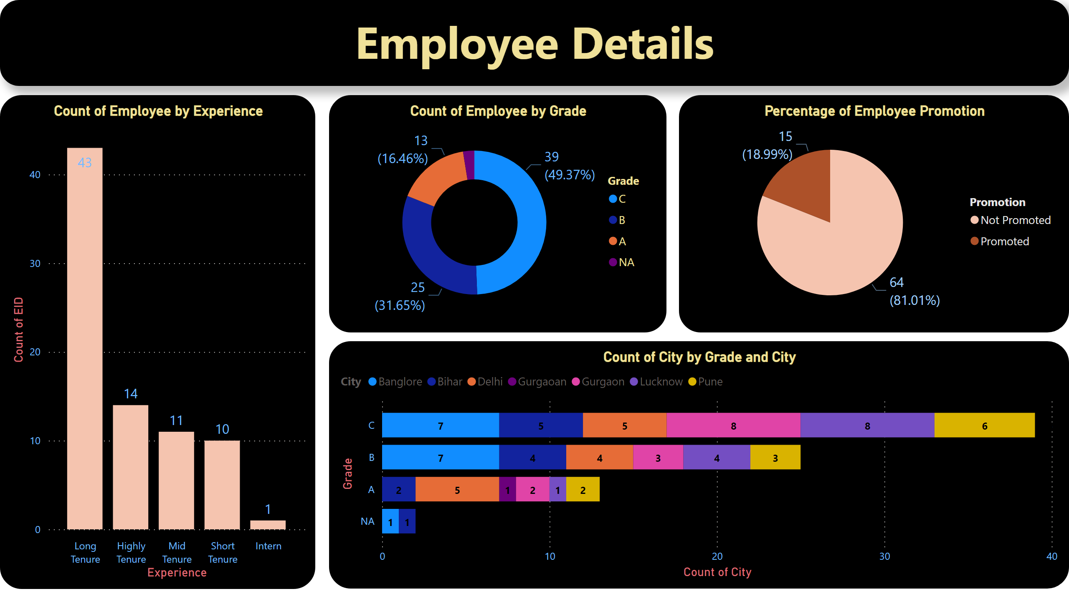
Page 1
Notes:
Count of Employee by Experience
No alt text provided
Count of Employee by Grade
No alt text provided
Percentage of Employee Promotion
No alt text provided
textbox
No alt text provided
barChart
No alt text provided

